Slide 1

MPTVHS Vocational Exploratory Program
2024-2025 School Year

Slide 2

What is the Vocational Exploratory Program?
The vocational exploratory program is your introduction to the vocational programs at Madison Park Technical Vocational High School.
Every Madison Park student participates in a vocational program, choosing from twenty different programs offered here at the school.

Slide 3
Madison Park Freshman Vocational Exploratory Program
DISCOVERY (1st phase)
    Twenty rotations
    Twenty days (1 day each)
EXPLORATION (2nd phase)
Five rotations
Five days each
.
5
20

Slide 4
DISCOVERY (1st phase)
      Twenty rotations
      Twenty days (1 day each)
Students travel in groups, and see each program for one day, for the full 3-hour block.
============
At the end of this phase, students fill out a choice sheet to select six programs that they would like to explore further (and will be assigned five based on space available.
20

Slide 5
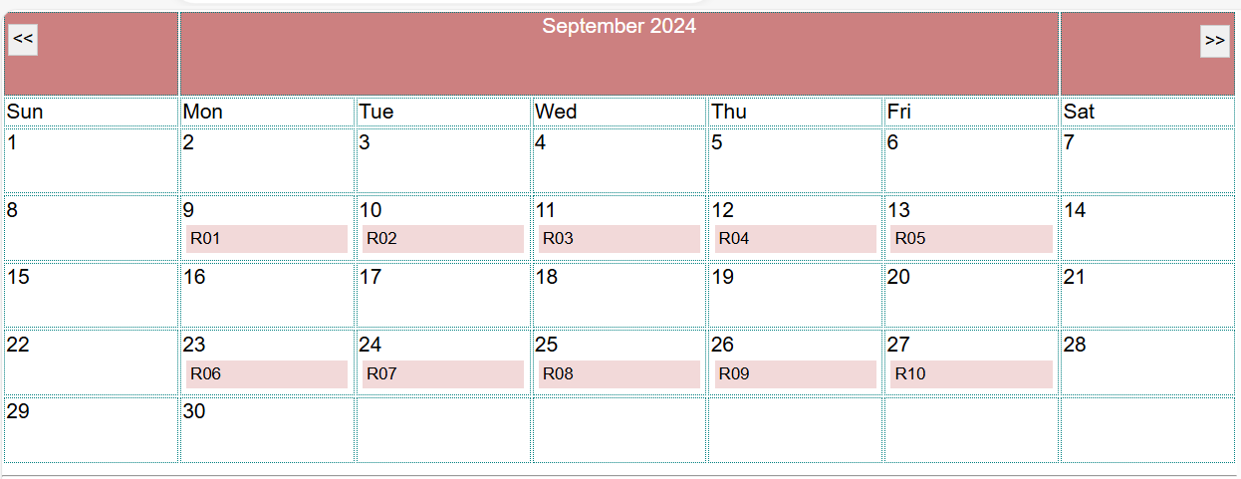
DISCOVERY (1st phase)
Discovery Phase begins September 9th.

Slide 6
EXPLORATION (2nd Phase)
Five rotations
Five days each
Students have individualized schedules based on their top choices.
========
At the end of this phase, students fill out another choice sheet to select their top choices. Permanent CVTE program assignments are made at the end of the program, based on choices, space available and points earned.
5

Slide 7
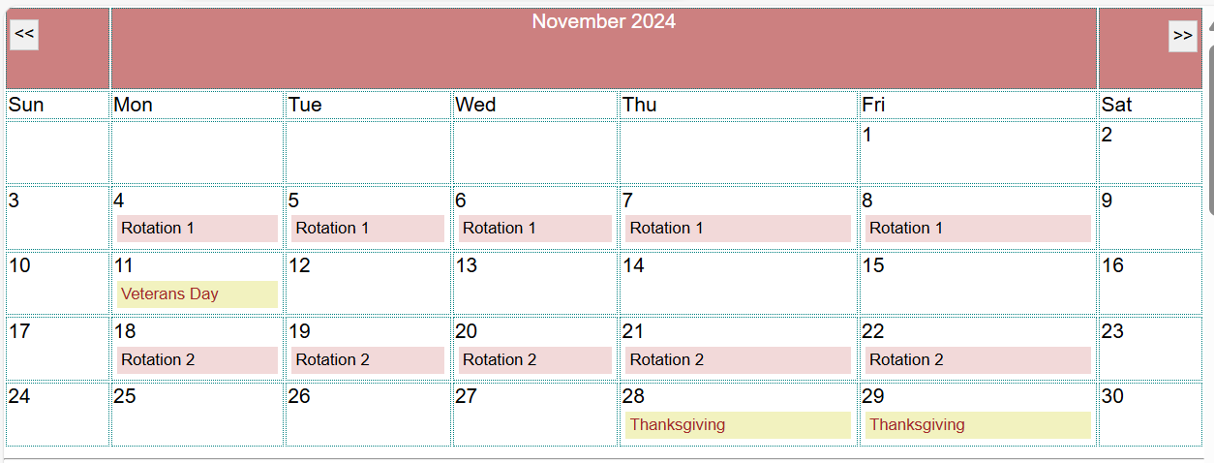
EXPLORATION (2nd Phase)
Exploration Phase begins in November and continues through January.
Notes:
The Exploratory calendar is posted in the database and at https://skillslibrary-bos.com/expcalendar.asp

Slide 8

Each day, you will receive an email telling you what shop you are attending, which will include a brief overview with:
the name and room number for your shop; and
a personalized link to the Skills Library student screens where you can see your schedule and write reflections.
Remember that during Exploratory weeks, your homeroom is in this room. Report here to homeroom each morning before going to your Exploratory rotation.

Slide 9
Advice for Getting Started

Slide 10
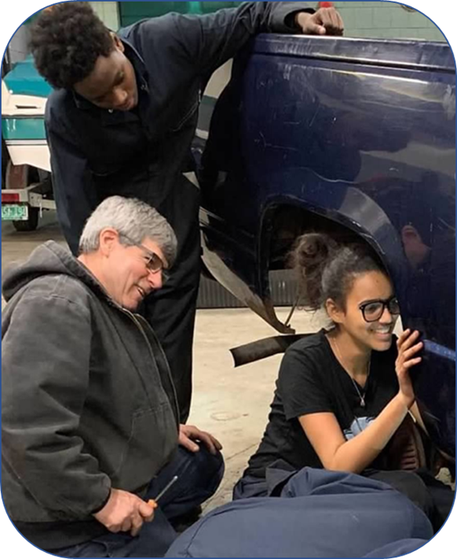

Advice for Getting Started
During Exploratory: You will earn Exploratory points for the work you do during the Exploratory Program. Your score will reflect:
~ your positive participation,
~ your hands-on and written work; and
~ professionalism and attention to safety.
The more points you earn, the better your chances of getting a spot in one of your
top-choice programs.

Slide 11
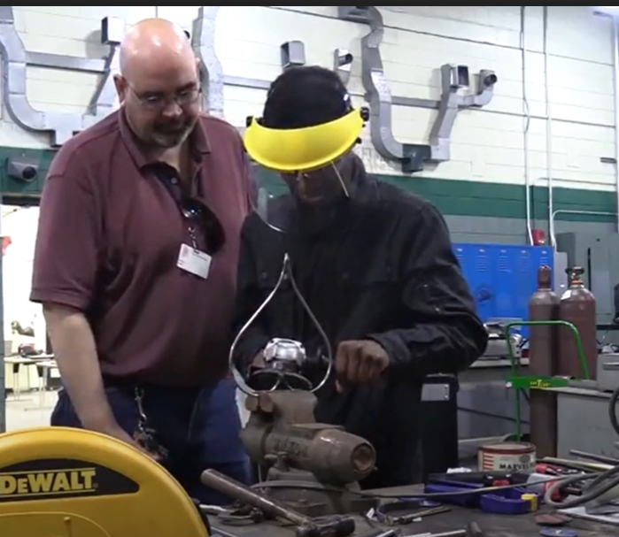
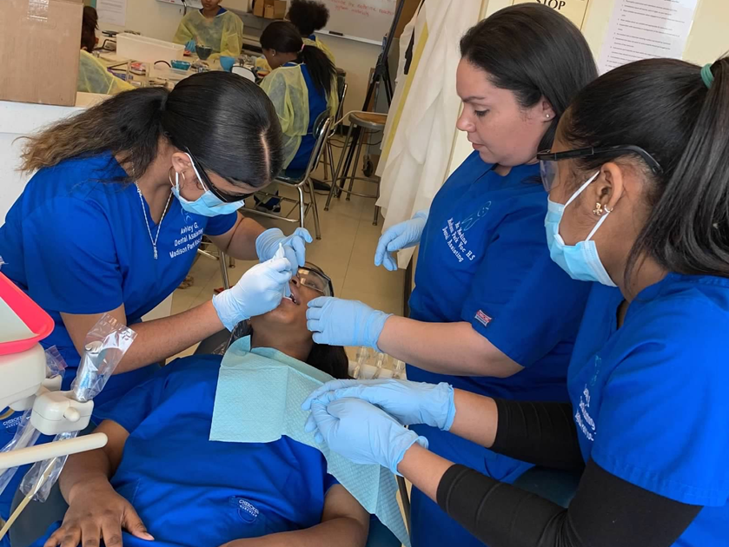
Advice for Getting Started
Participating in each class: We know that some students already know what type of program they hope to enter; others are not at all sure. Either is fine!
Every exploratory session gives you an opportunity to spend a day exploring something interesting – something that may provide general life skills or be a personal interest -- even if it is not necessarily one of your top choices. Sometimes students discover new interests through this process!
Keep in mind that your exploratory score is based on your positive participation in all rotations, a reflection of your professionalism in all types of settings.

Slide 12

Advice for Getting Started
Safety: During the program, you will be able to work with some of the tools, equipment and materials used in each shop. Your instructor will explain all important safety guidelines that must be followed.

Slide 13
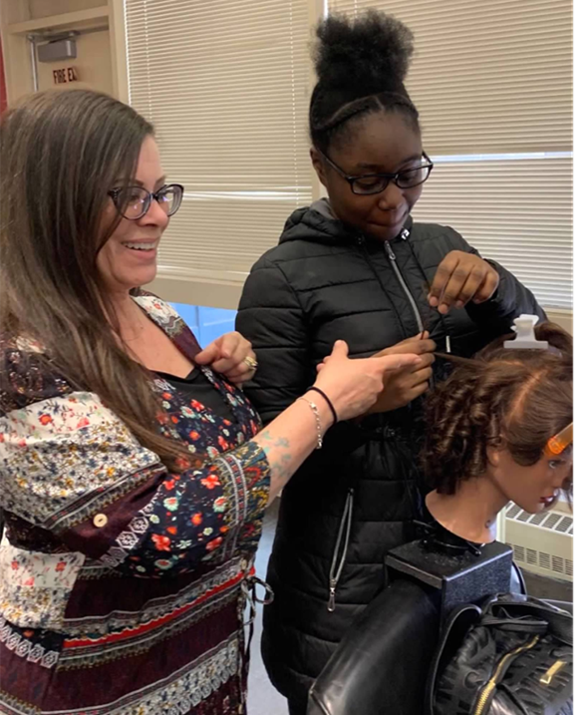
Advice for Getting Started
MAKING CHOICES: All students who graduate from vocational programs follow a wide variety of career paths, sometimes following a straight-line path to a career based on their program and sometimes using those same skills in a variety of different ways.
During the program, you will think about your short-term and long-term interests, about what you will enjoy during the next four years, and about how you can use the skills you will learn in the future.
Keep an open mind and enjoy the process of exploring!

Slide 14

Advice for Getting Started
Talk to family members: During the Exploratory Program, talk to your family and friends about the programs you are participating in and see if they have any questions or comments. Also, find out if anyone in your network of family and friends works in a career field that might interest you.

Slide 15

Advice for Getting Started
Reflection: As part of the program, you are required to write an online reflection journal entry at least once per rotation. Use these reflection journals as an opportunity to describe what you are learning and reflect on how it matches your short-term or long-term goals and interests. You can look back at these reflection journal entries when it is time to make program choices.

Slide 16
Schedules, etc.

Slide 17

You will receive an email each day with your shop schedule for the day throughout both phases of the Exploratory Program, which will include the link to sign in to see your schedule, and complete your online reflection journal entries.
The email will come from exploratory@skillslibrary-bos.com
You can find all of the information you need and can complete reflection journal assignments in the student screens.

Slide 18
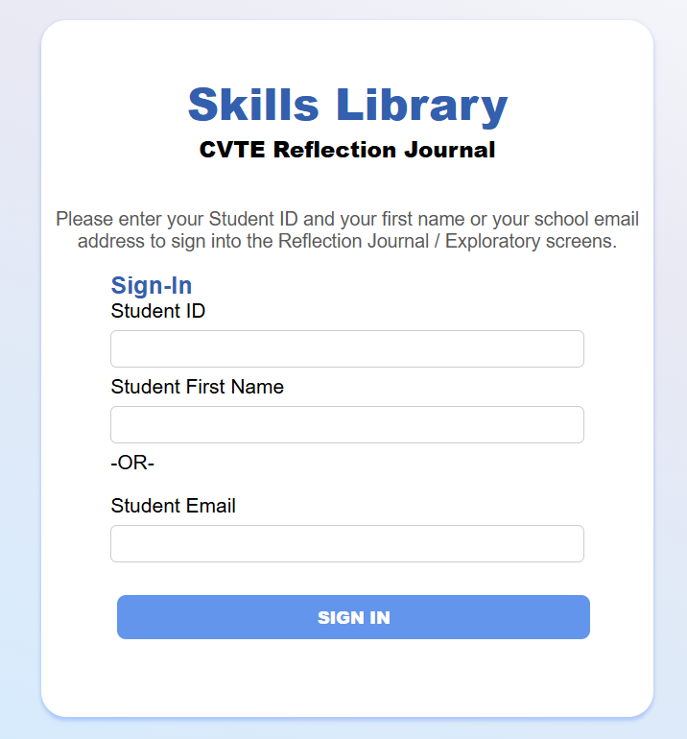
Use the shortcut link reflectionjournal.me
or the full link at https://skillslibrary-bos.com/studentpages
An individualized link is also provided
via the emails.
You will initially sign in with your student ID and name and then later be prompted to set your own password.

Slide 19
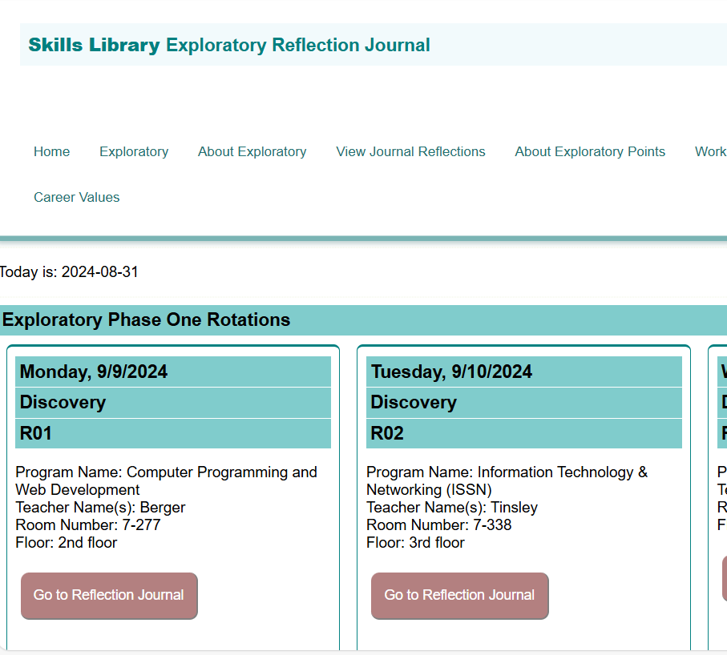
The Exploratory screen includes your personalized schedule. For each day of the program, you will see the date, program name, teacher name and room number.
From the sign-in page and dashboard, You can click EXPLORATORY to see your schedule.

Slide 20
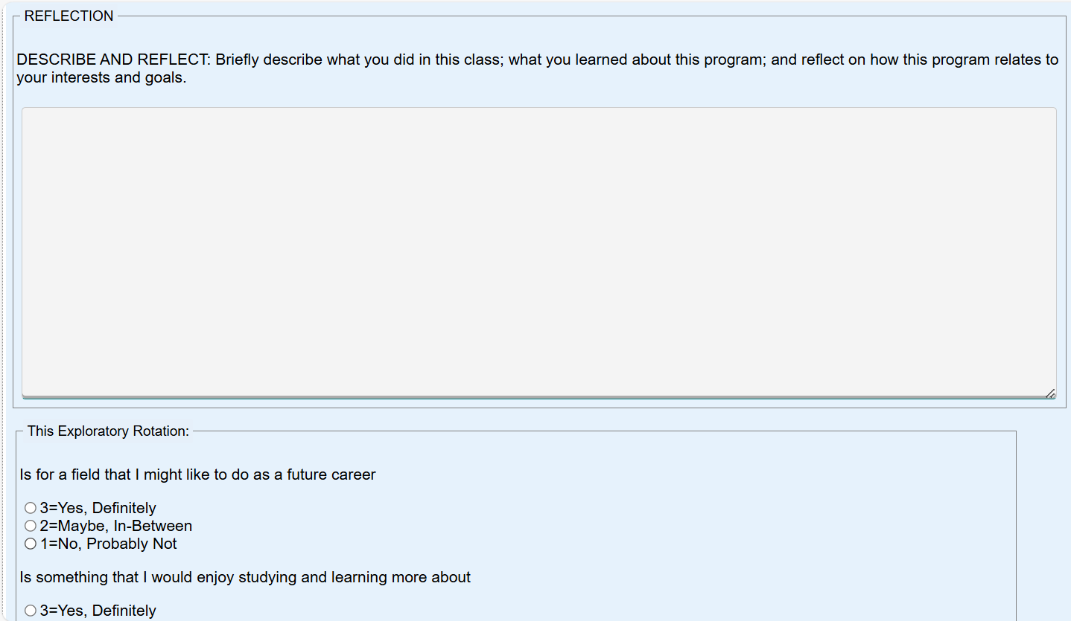
This is the reflection screen. You can write and SAVE your reflections for each session.

Slide 21
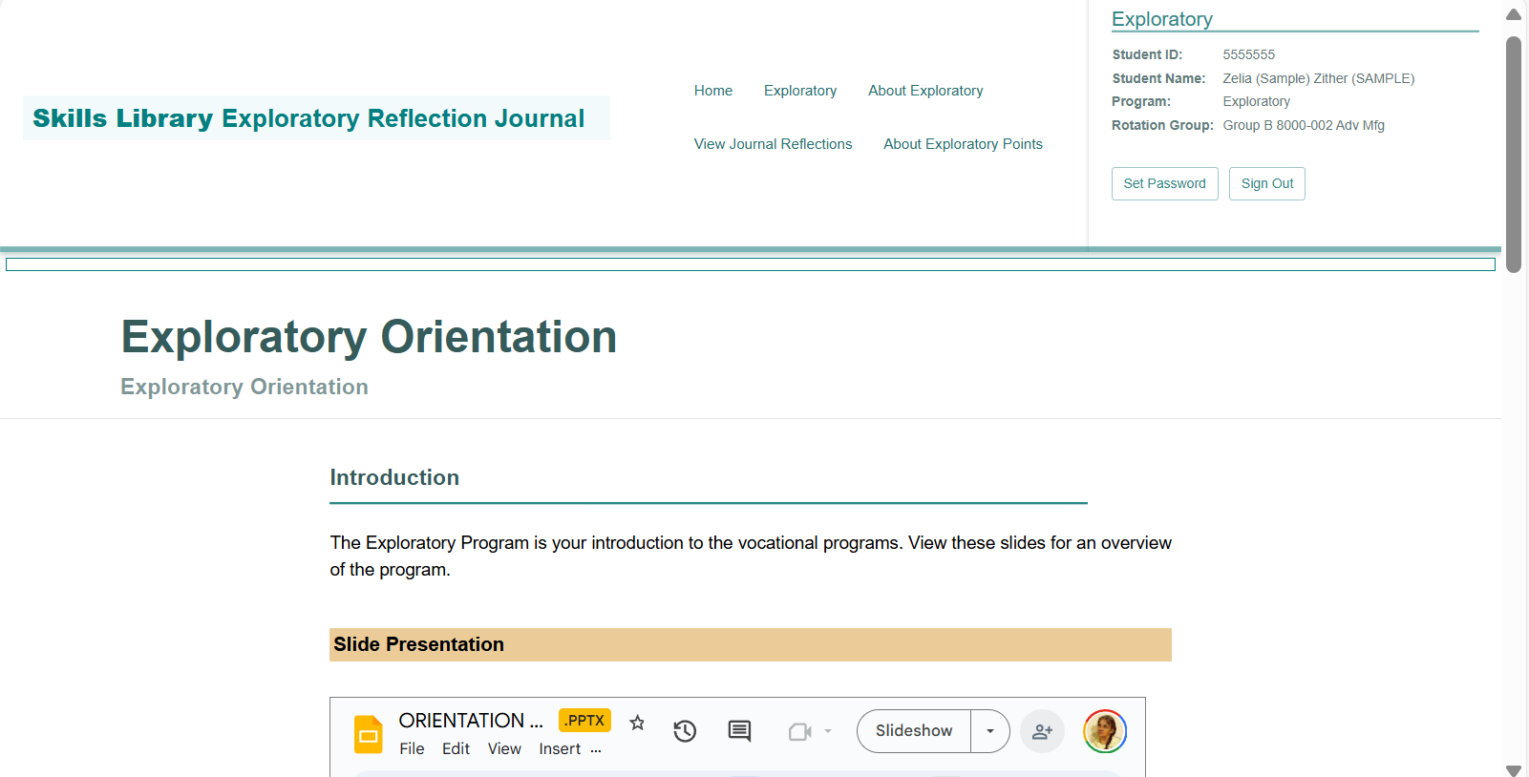

Your can view other items as well, including:
this Exploratory Orientation slide show and notes about the Exploratory Program;
your Exploratory score; and
your reflection journal entries.
Program choice forms are posted on this site near the completion of each phase of the program.

Slide 22
Discussion & Questions

