Slide 1
Exploratory Teacher and Student Screens
Skills Library Database
Fall 2023
For technical assistance:
Jennifer Leonard | jleonard@skillslibrary.com| Phone/Text: 781-321-7894

Slide 2
QUICK REFERENCE
FOR ANY TEACHER / STAFF: (SHARE THIS IN A GOOGLE DOC): Find today’s schedule for any student: https://skillslibrary-[schoolname],https://skillslibrary.comcom/scheduletoday.asp
Master Schedule (By Rotation Group – Group A to Group T)
https://skillslibrary-[schoolname],com/phase1rotations.asp
Calendar
https://skillslibrary-[schoolname],com/mpcalendar.asp
THESE REFERENCE SCREENS + MORE ARE ALSO AVAILABLE WHEN YOU SIGN IN TO THE SKILLS LIBRARY:
https://skillslibrary-[schoolname],com
STUDENT SCREENS: Use individualized link or sign in with name & student ID at skills-[school].me

Slide 3
Exploratory Student Screens
Skills Library Database
Fall 2024

Slide 4
Before the first exploratory week begins, students receive an email telling them that the exploratory program is beginning, with a brief overview plus:
the name of their first class;
a personalized link to the student screens
Sample screen: _____________
If students don’t have their personalized link they can go to ______ and sign in with their student ID and first name and email address.

Slide 5
Students will receive an email each day with their rotation schedule for the day; throughout both phases of the Exploratory program., and with the link to sign in to see their schedule and complete their online reflection journal entries.
The email will come from exploratory@skillslibrary-[schoolname].com
Students can find all of the information they need and complete their journal assignments in the student screens.

Slide 6
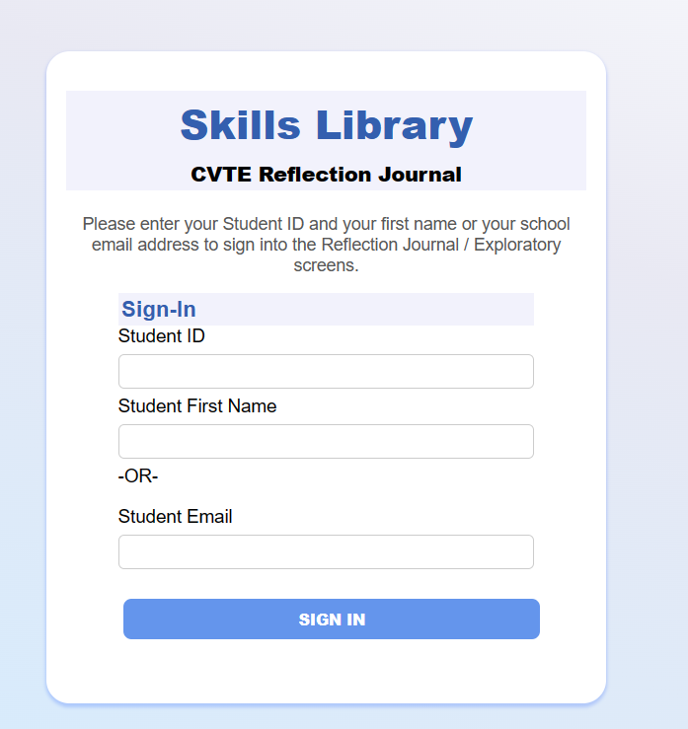
The individualized link bring students to a home page (see next slide) or the link brings students to this sign-in screen
Students initially sign in with their name and email or ID, and later set their own password.

Slide 7
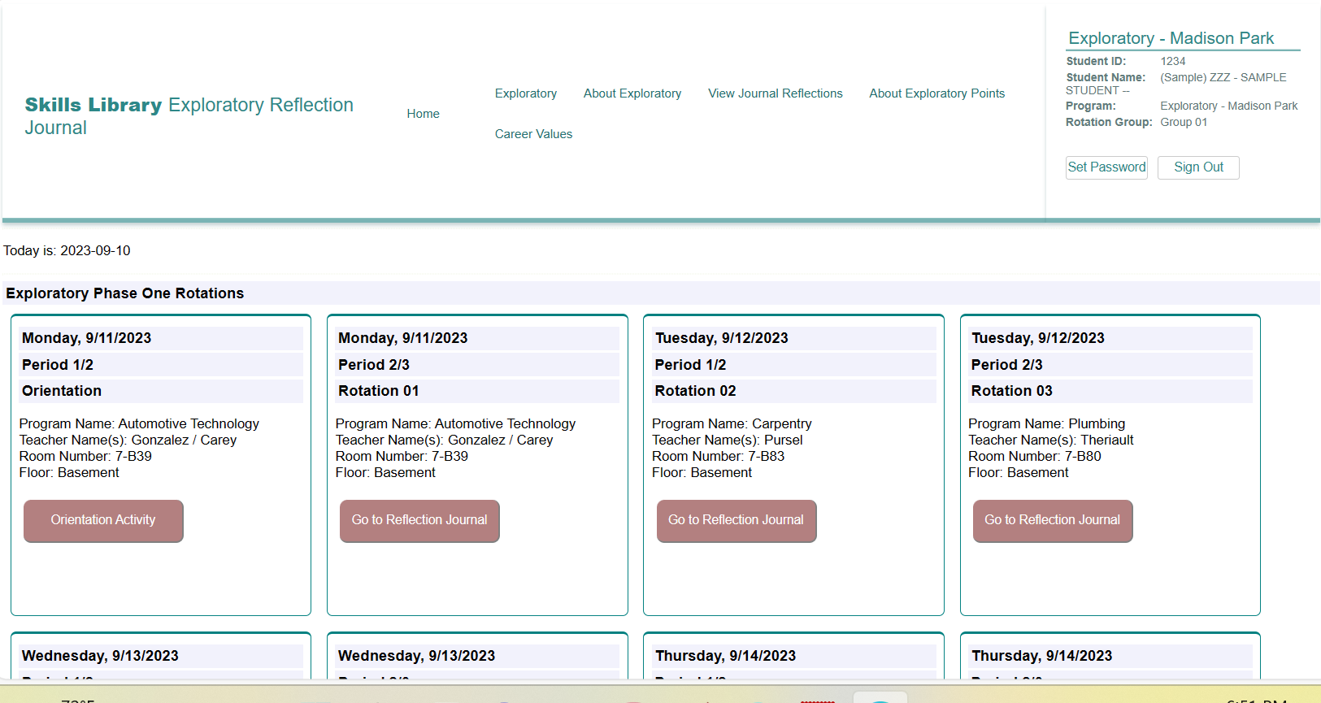
The student screens includes the student’s personalized schedule. For each day of the program, they see the date, time, program name, teacher name(s) and the room number and floor.
From the signin page and dashboard, students click EXPLORATORY to see their schedules.

Slide 8
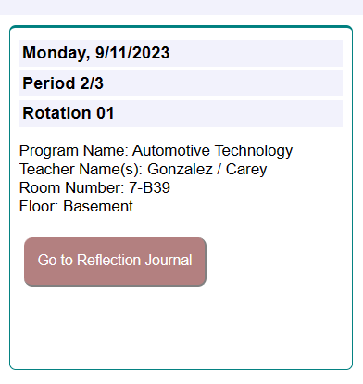
Students will write a brief reflection journal entry for each session.
Students earn exploratory points for completing these entries.
Once an entry is completed, a checkmark will appear in the box.

Slide 9
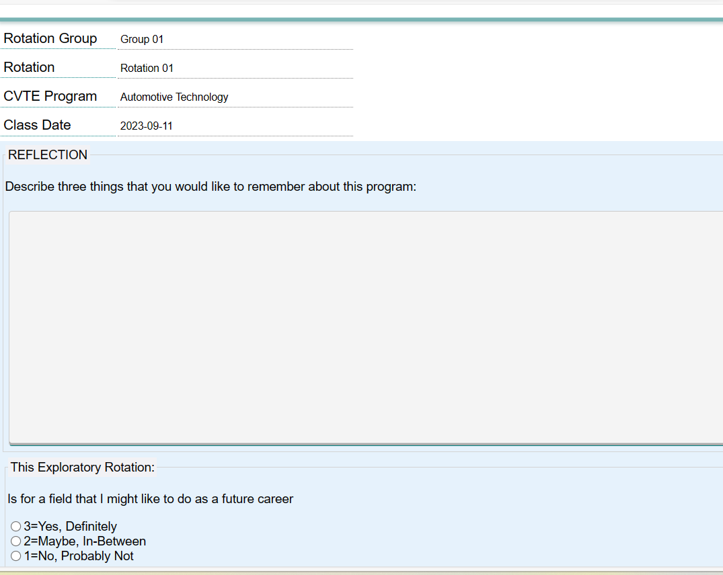
This is the reflection screen. Students write and SAVE their reflections for each session.

Slide 10
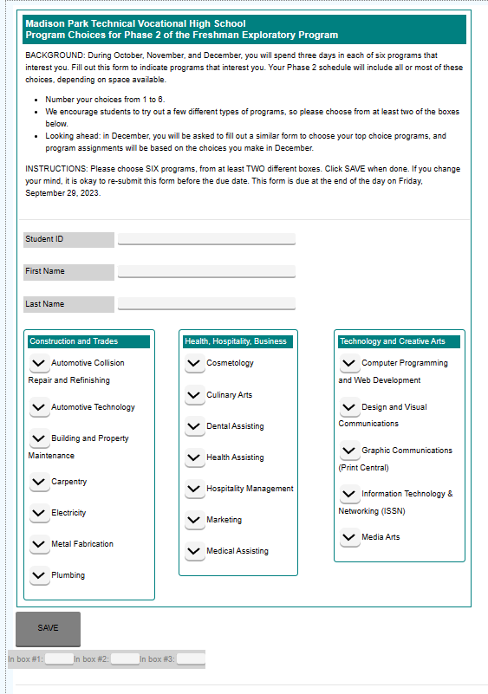
Later in the Exploratory program, students will use the Exploratory screens to fill in program choice forms, career interests exercises, surveys or other items.

Slide 11
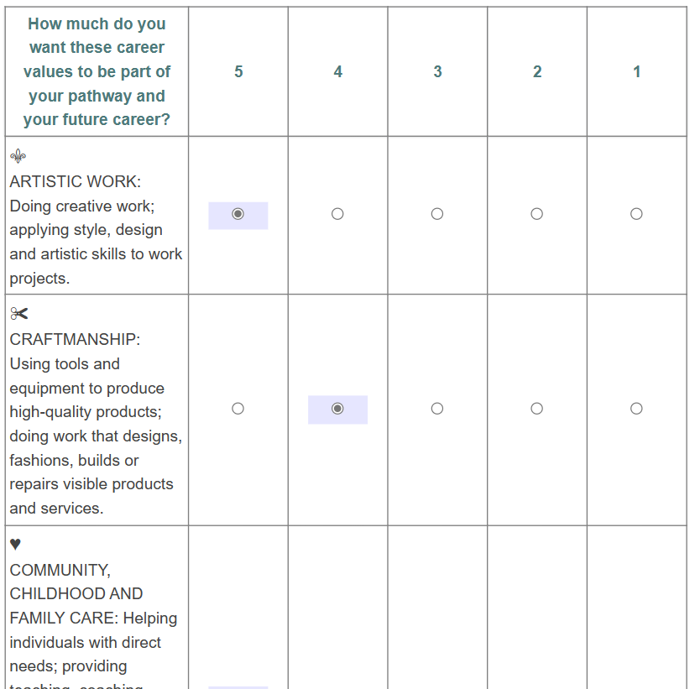
Later in the Exploratory program, students will use the Exploratory screens to fill in program choice forms, career interests exercises, surveys or other items.

Slide 12
Exploratory Teacher Screens
Skills Library Database
Fall 2024

Slide 13
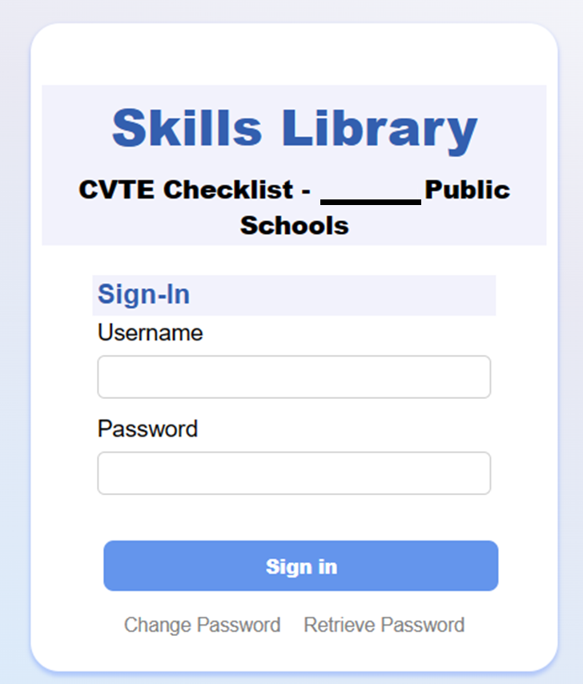
Sign into the Skills Library database at https://skillsibrary-[schoolname].com (or go to skillslibrary.com and look in the corner for a link).
Email Jennifer Leonard at jleonard@skillslibrary.com for a username and password.

Slide 14
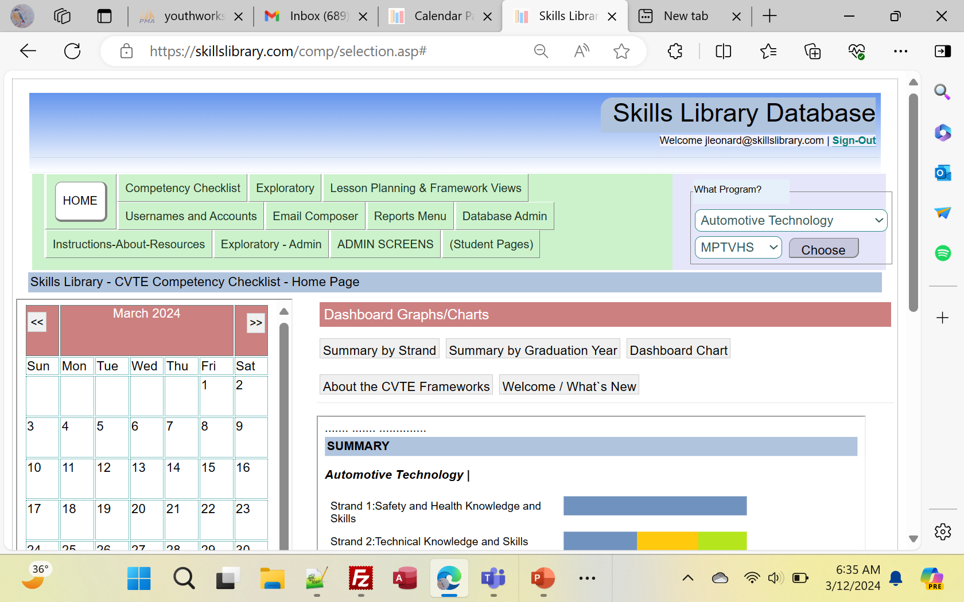
The exploratory calendar and other features appear on the home page.
All of the Exploratory screens are found under the tab “Exploratory” on the navigation bar along the top.

Slide 15
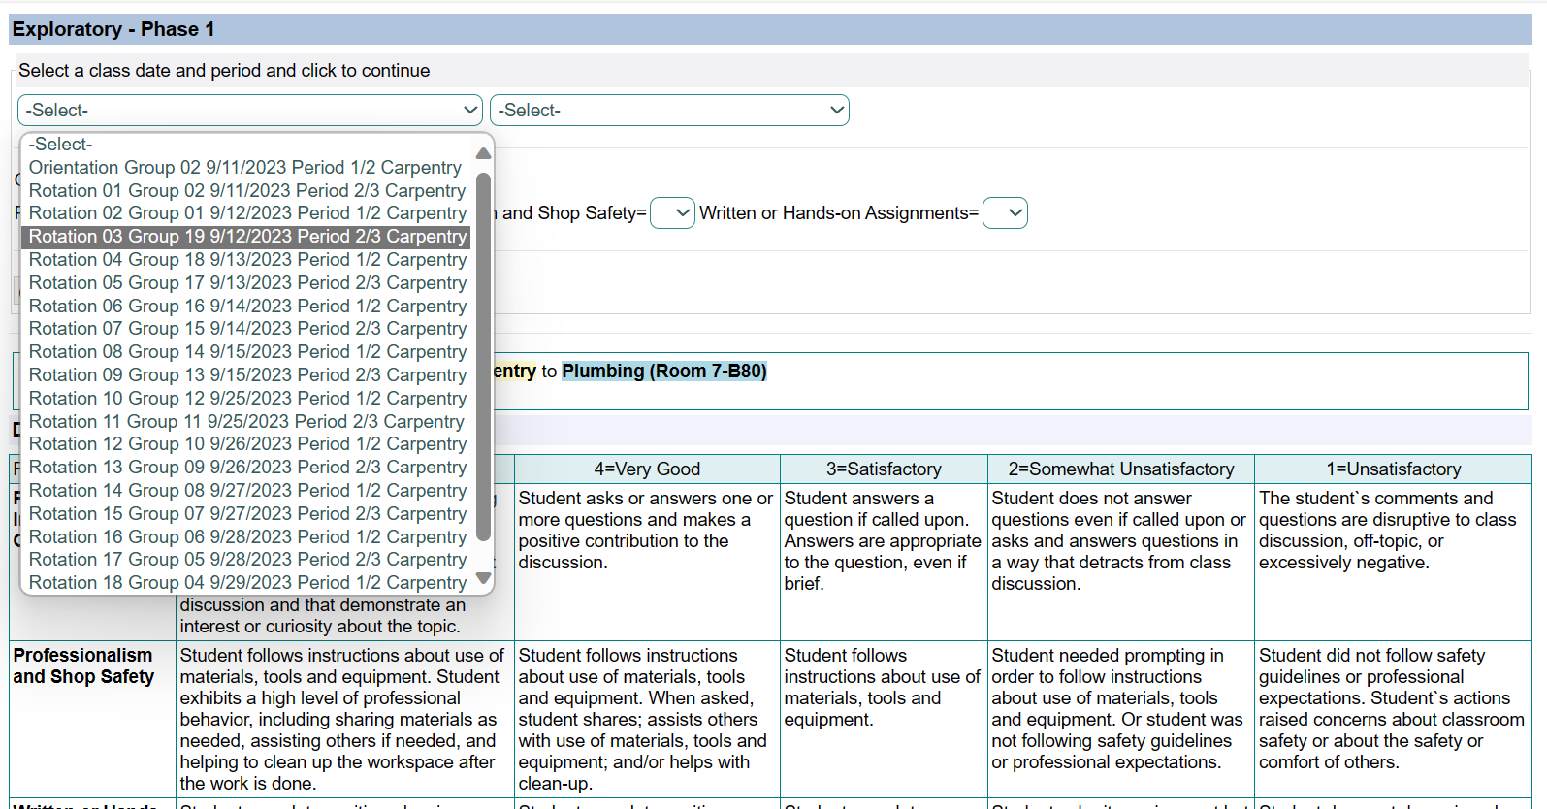
(1) Under the “Exploratory” tab, click on the link for Phase 1 – Attendance and Rubric to open the screen that you will use to track attendance and scores.
(2) When that screen opens, choose a ROTATION and a DATE and click CONTINUE.

Slide 16
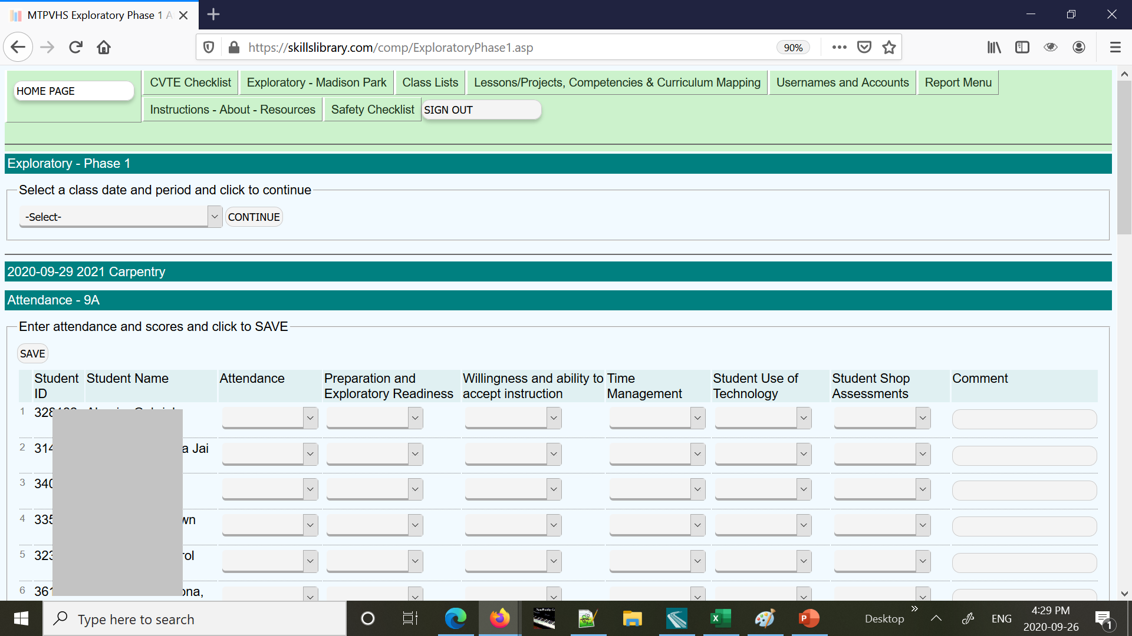
This is the screen for entering attendance and scores. Student names appear along the right, and there are columns for the Attendance and for the scores in the different rubric categories.

Slide 17
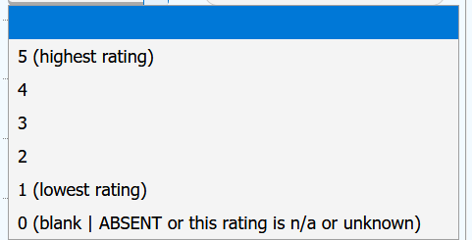
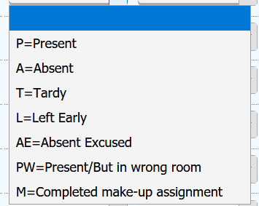
The attendance column has a dropdown with codes including P for Present, A for Absent, M for Make-up class, and other options.
The rubric columns have a dropdown list with a 1-5 scale, with 5 as the best score. Leave blank (or zero) if the student was absent or if an item is not applicable or unknown. Zeroes will not count in the final exploratory scores.

Slide 18
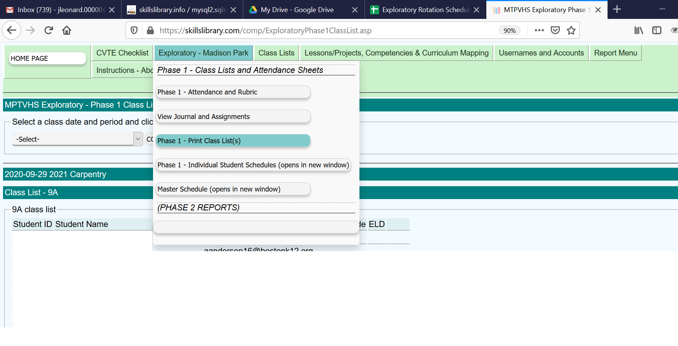
Click on “Phase 1 – Print Class List(s)” to view and print class lists.
You can choose a class date and print each list as you need it. You can print the class list screen or the “Phase 1 - Attendance and Rubric” screen as an aid for taking attendance and assigning points.

Slide 19
Look under the Exploratory tab for summaries of the Reflection Journal entries, Attendance, and other data.
For Administrators – Look under the Exploratory – Admin tab for screens for creating the calendar, managing class lists, and other tasks.

